Slide 1
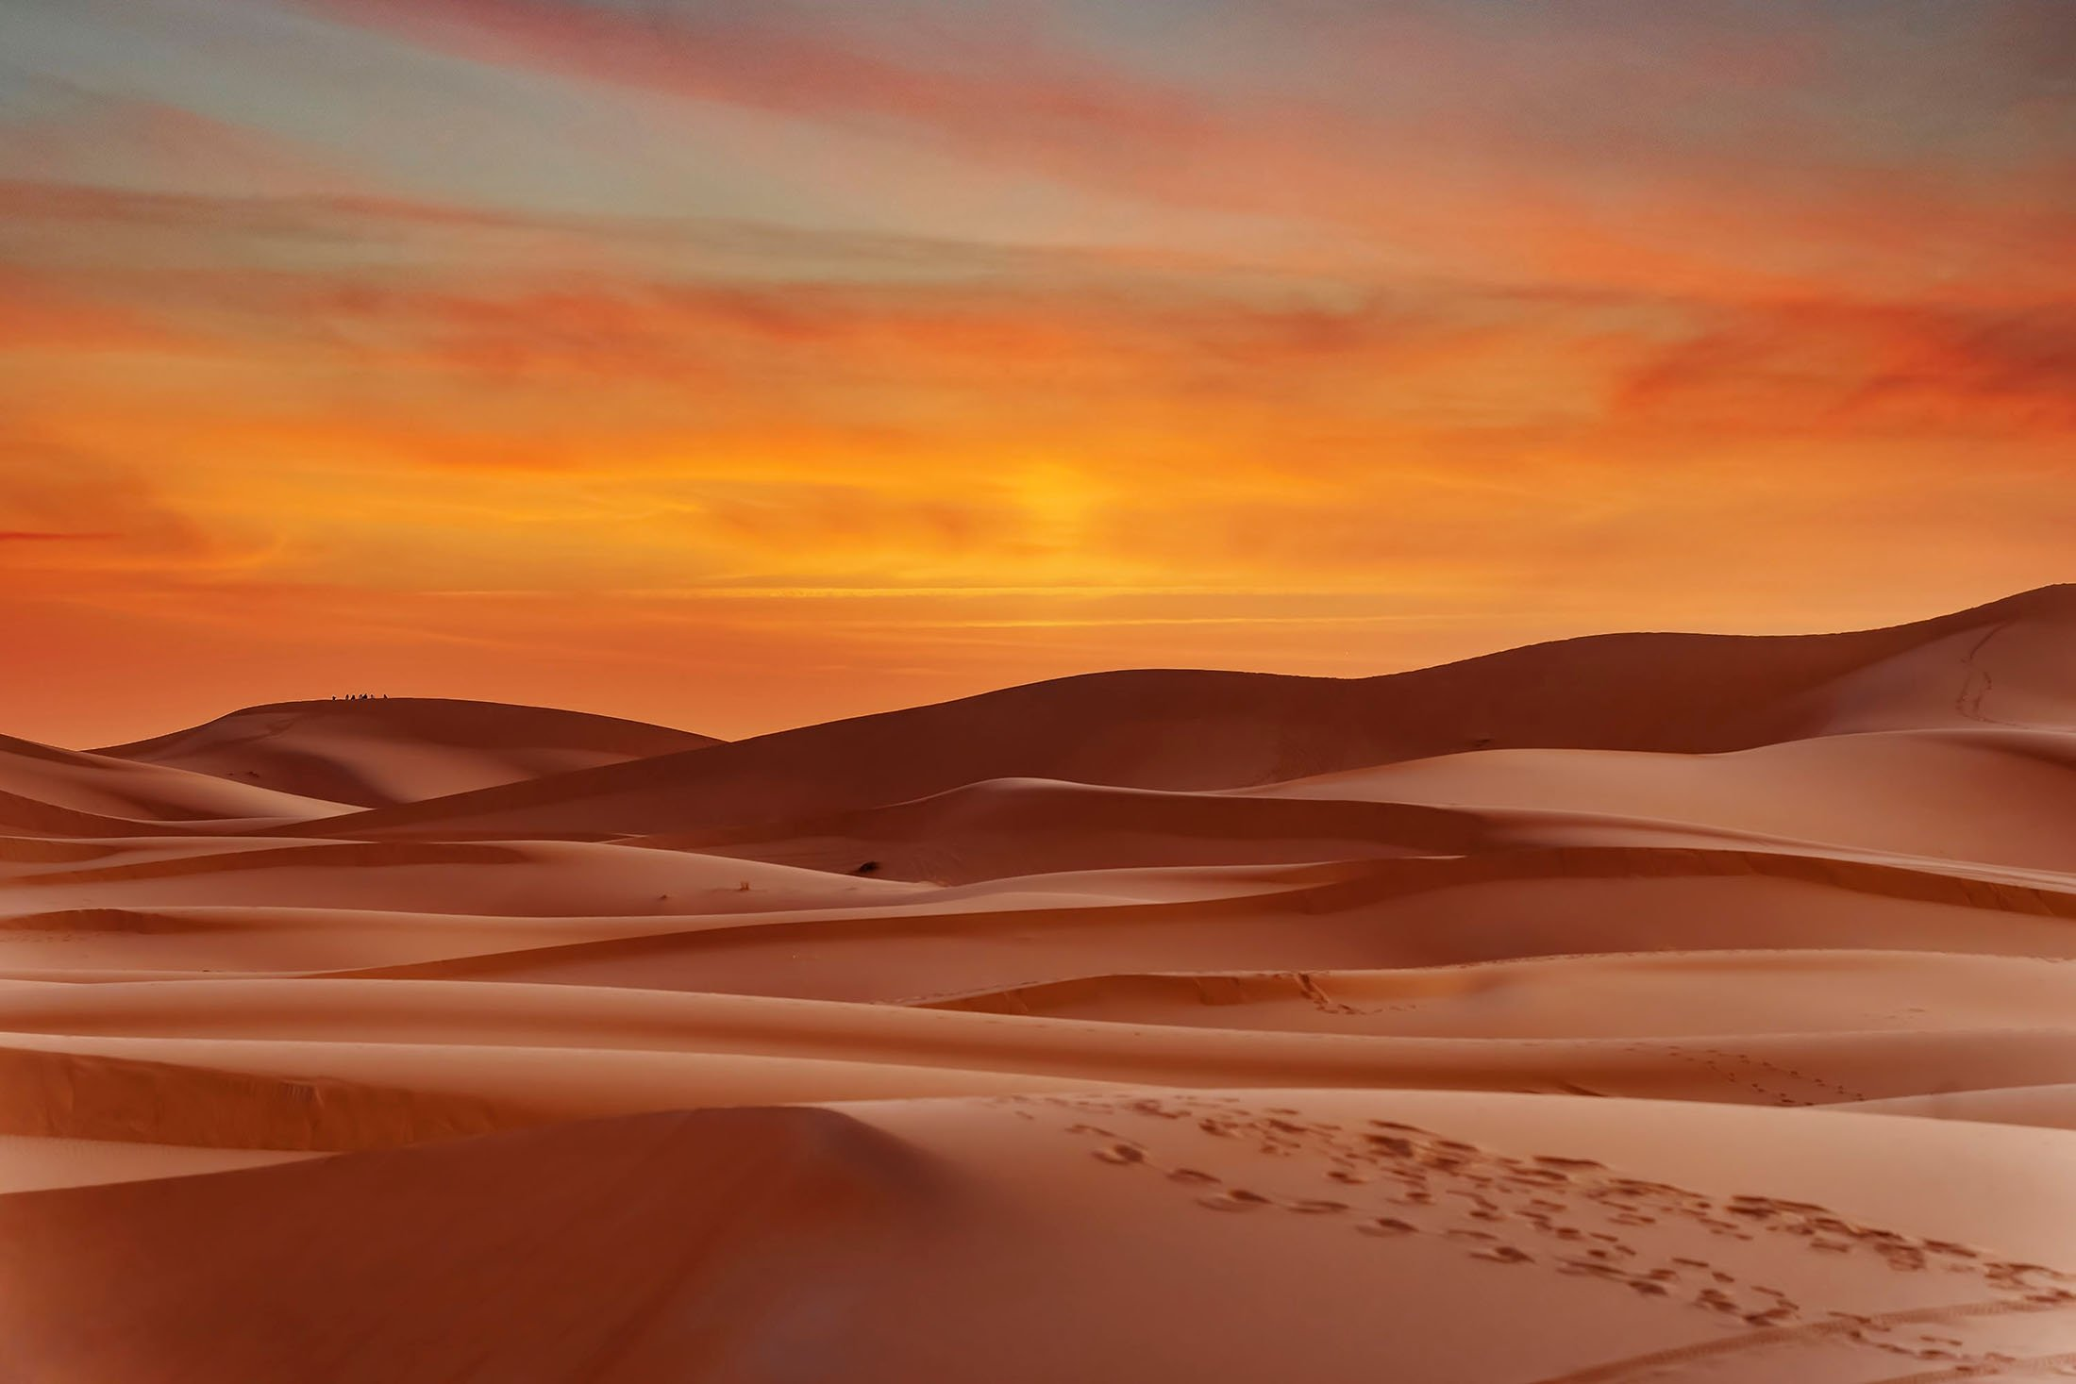
مَرْحبًا كَيْفَ حَالك
Marhaban how are you
Seloua Nedjai

Slide 2
Teacher:
Read the story using daf
Get them to repeat after you the sentences
مرحبا أهلا كيف حالك أنا بخير شكرا
Let them guess the end of the story

Slide 3

The camel wanted to go around the world and he went to seek advise from the wise Monkey

Slide 4
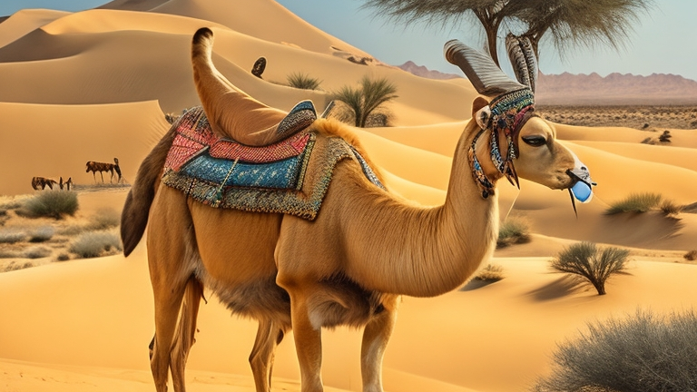
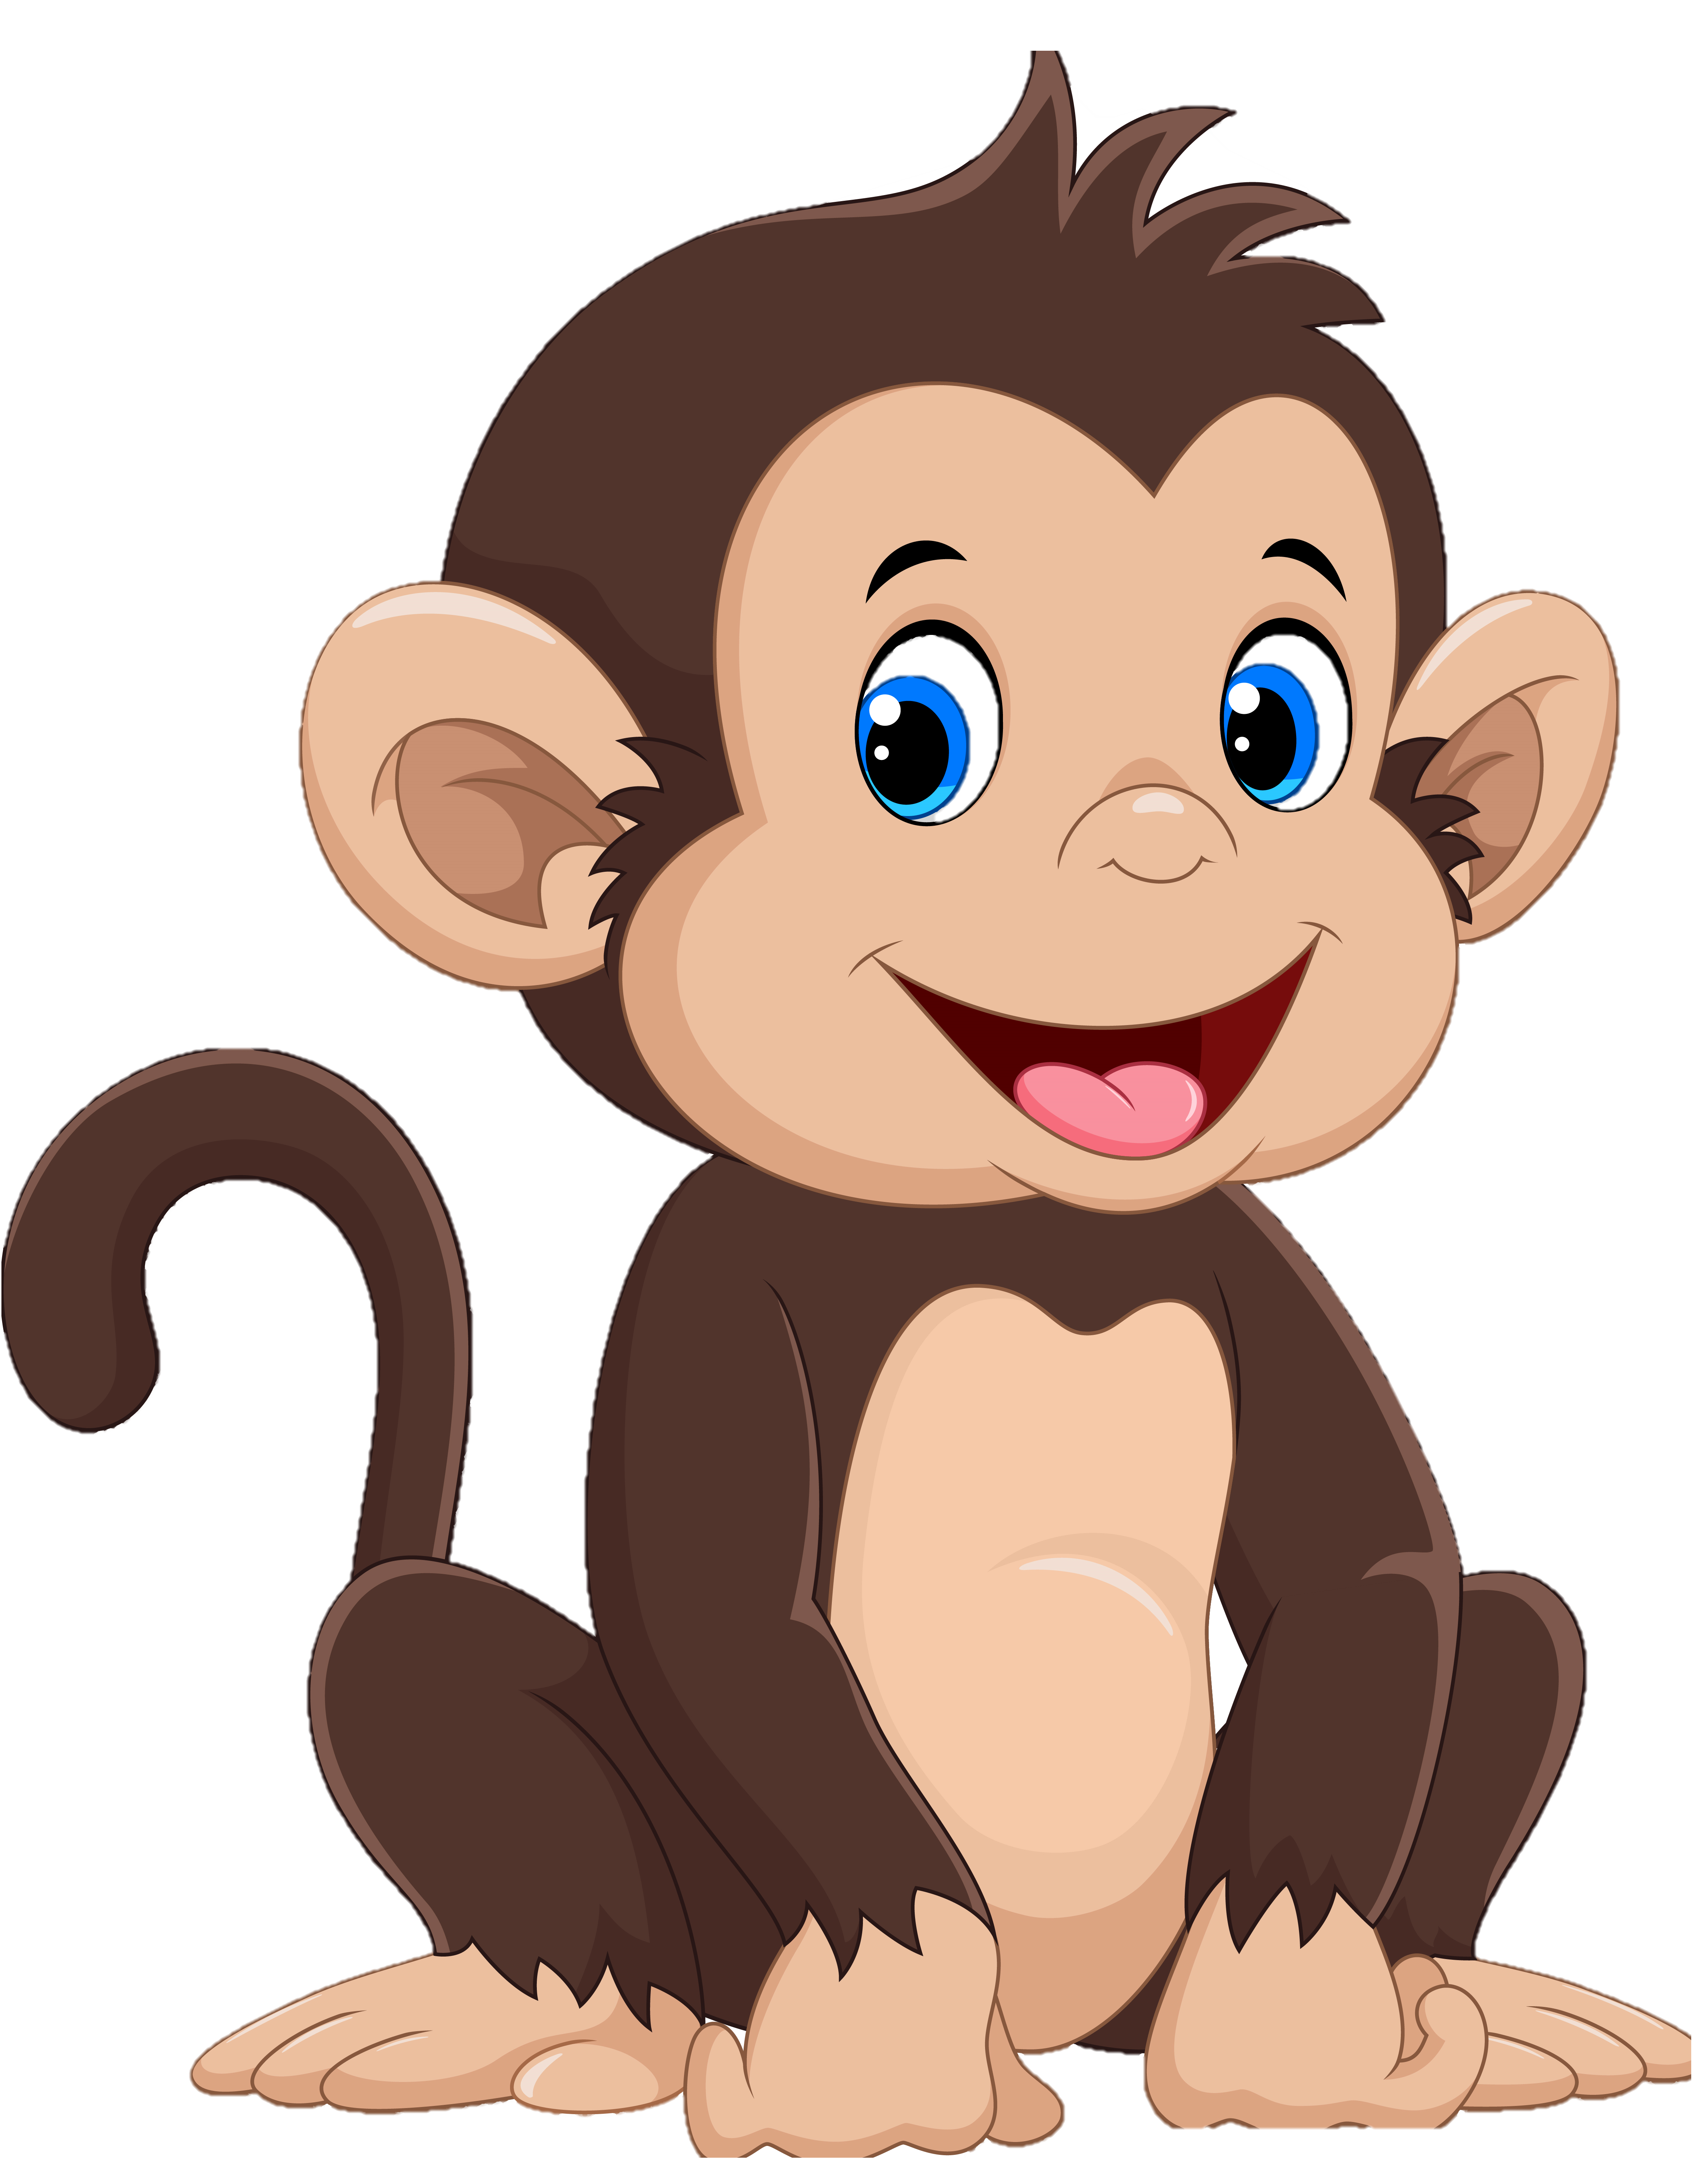
أرَاد جَمَلٌ السّفَر فنصحهُ صدِيقُهُ القِرد و قَال

Slide 5
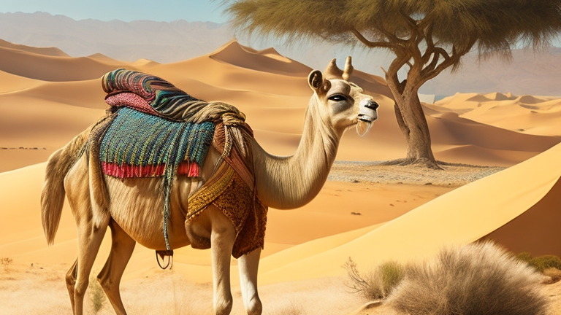
ابتسم و قُل مَرْحَبًا لكل مَن تُقَابِل
The monkey said: smile to all the one you meet and say hello

Slide 6
وَ قُل كِيْفَ حَالُك؟
The monkey said: smile to all the one you meet and say hello

Slide 7
وَ قُل أَنَا بِخَير وَ شُكْرًا
The monkey said: smile to all the one you meet and say hello

Slide 8
The camel set off and in his journey, he met the donkey
إنْطَلَقَ الجَمَل و فِي رِحْلَتِهِ إِلْتَقى بِالحِمَار

Slide 9
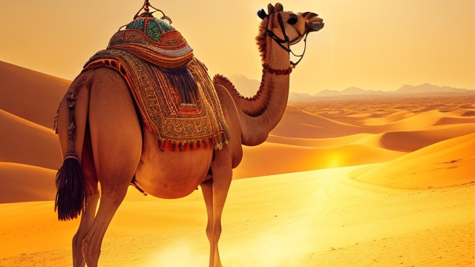
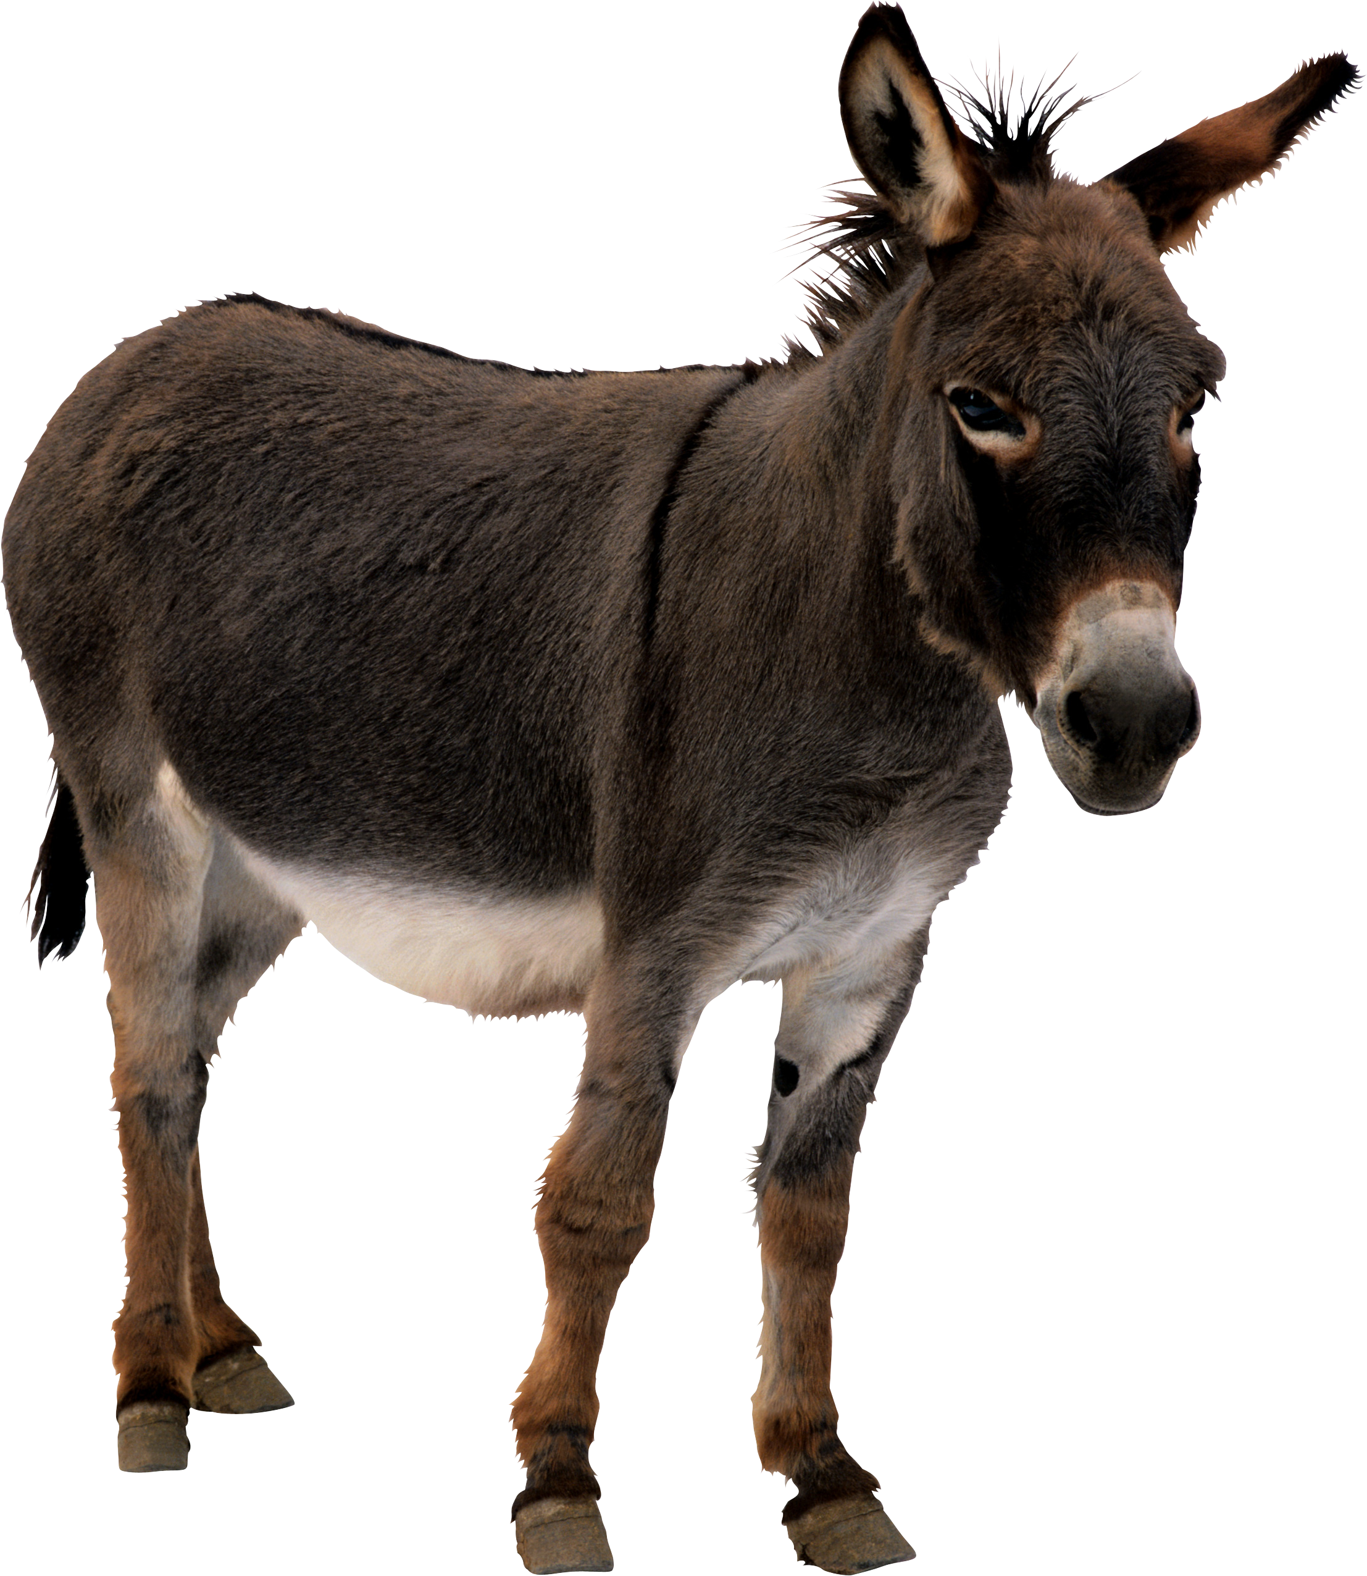
مَرْحَبًا
أَهْلاً
كَيْفَ حَالُك؟
أَنَا بِخَيْر شُكْرًا

Slide 10
He said : marhaban
The donkey answered: Ahlan
The jamel: said kayfa haaluk
The donkey answered ana bekhair shukran

Slide 11
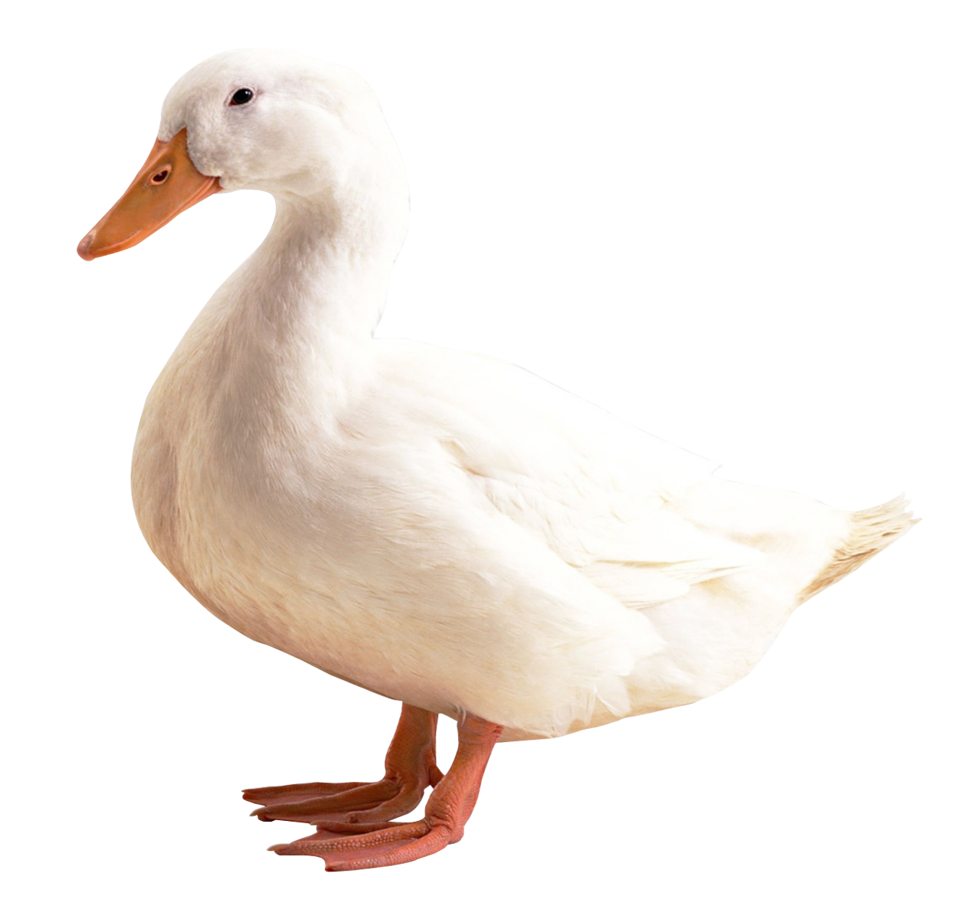
مَرْحَبًا
أَهْلاً
كَيْفَ حَالُك؟
أَنَا بِخَيْر شُكْرًا

Slide 12
The jamel met the duck
He said : marhaban
The Duck answered: Ahlan
The jamel: said kayfa haalok
The duck answered ana bekhair shukran wa kaifa Anta
Ana Bikhair

Slide 13
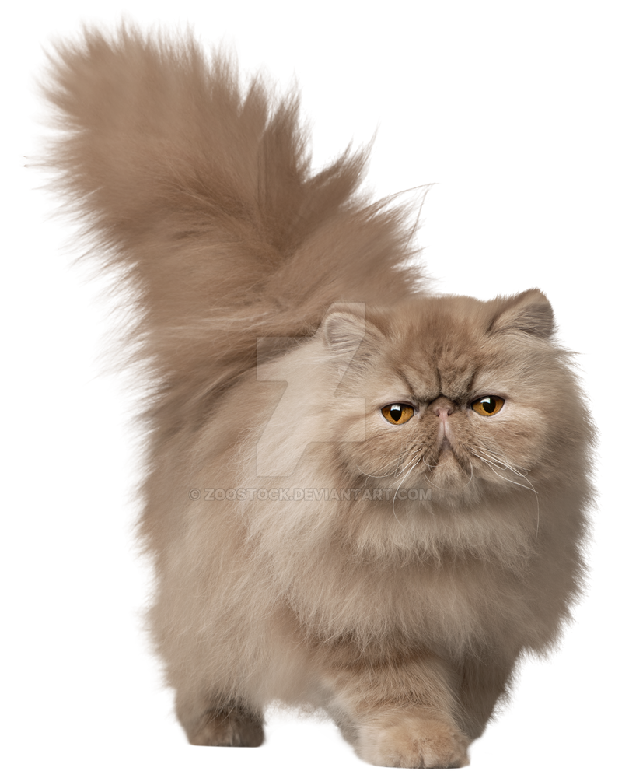
مَرْحَبًا
أَهْلاً
كَيْفَ حَالُك؟
أَنَا بِخَيْر شُكْرًا

Slide 14
The jamel met the cat
He said : marhaban
The cat answered: Ahlan
The jamel: said kayfa haaluk
The cat answered ana bekhair shukran wa kaifa Anta
Ana Bikhair

Slide 15
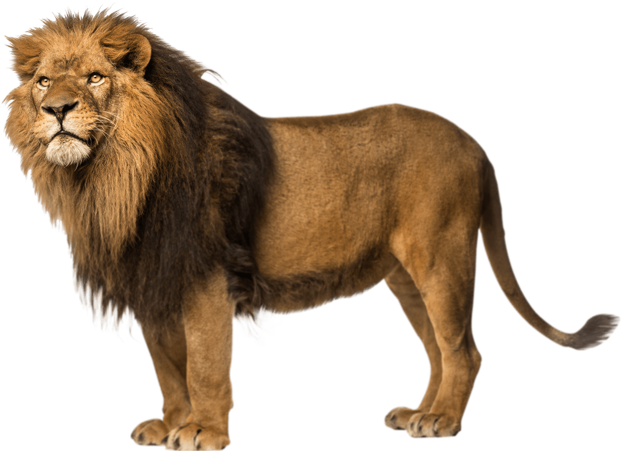
مَرْحَبًا
أَهْلاً
كَيْفَ حَالُك؟
أَنَا بِخَيْر شُكْرًا

Slide 16
The jamel met the lion
He said : marhaban
The lion answered: Ahlan
The jamel: said kayfa haaluk
The lion answered ana Jaaih
Ana Bikhair OOOOOOOO
Run away

Slide 17
