Slide 1
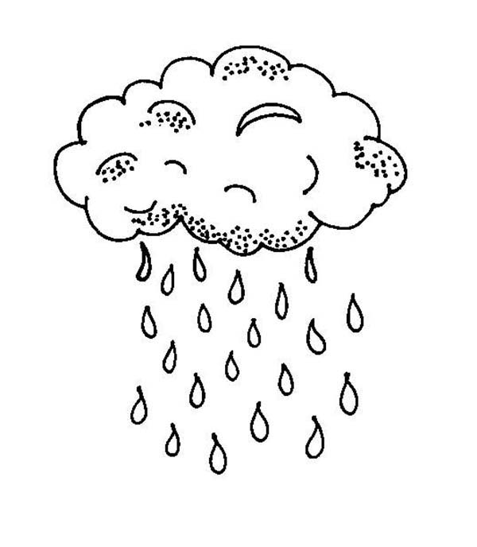



العُطْلَة
عِندَمَا
when
Please use your vocabulary
Name:
Class:
Date:...............................
Due Date: ................................

Slide 2
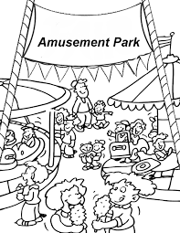
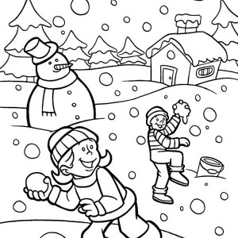
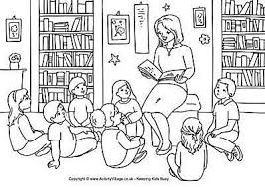
Read and match the sentence to the picture
عندما كان الطّقس ممطرا ذهبت إلى المكتبة
عندما كان الطّقس غائما ذهبت إلى مدينة الملاهي
٣
١
عندما كان الطّقس مشمسا ذهبت إلى البيت
عندما كان الطّقس مثلجا ذهبت إلى الحديقة
٤
٢

Slide 3
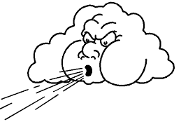
Read and understand
كان=was
يكون=is
سيكون=will be
اليوم =today
غدا=tomorrow
البارحة=yesterday
Choose the correct verb in the empty gap:
غدا...............الطّقس باردا
البارحة..............الطّقس عاصفا
اليوم.................الطّقس مشمسا
مشمس
Circle the word matching the picture.
ممطر
مثلج
Translate the following sentences:
غائم
Yesterday the weather was cold
…......................................................
Tomorrow the weather will be hot
................................................................
Today the weather is windy
..................................................................
ممطر
عاصف

Slide 4
Fill the gap with the following words and translate the text in next page.
أُمِّي عندما ذهبت دُبَي الرّبيع الطّقس
عِنْدَمَا كاَنَ ..................مُمْطِرًا ذَهَبْتُ إلى الْمَتْحَفِ و ............كان الطَّقْسُ عَاصِفًا ............إلى الْمَكْتَبَةِ.
في عُطْلَةِ الصَّيْفِ ذَهَبْتُ مَع ..............و أَبِي إِلىَ مَدِينَةِ الْمَلاَهي، قَضَيْنَا يَوْمًا رَائِعًا. في عُطْلَةِ .................زُرْنَا مَتْحَفًا في لُنْدُنْ. في عُطْلَةِ الشِّتَاءِ سَافَرْنَا إلى ...................كَانَتْ الرِّحْلَةُ مُمْتِعَةً جِدًّا.

Slide 5
Fill the gap with the following words and translate the text in next page.
Read the text, write the plan for the text in English, find the verbs and circle it. Create similar text using different country and different places:
فِي عُطْلَة الصيف سَافَرْتُ إِلَى إِسْبَانْيَا بِالطَّائِرَة .كاَنَ الطَقسُ مُشْمِسًا وَ جَمِيل.
فِي إِسْبَانْيَا ذَهَبْتُ إلى الْمَتْحَفِ و إِلَى مَدِينَة المَلاَهِي بِالسَّيَارَة. وَ كَذَا
في عُطْلَةِ الصَّيْفِ ذَهَبْتُ مَع أُمِّي و أَبِي إِلىَ مَدِينَةِ الْمَلاَهي، قَضَيْنَا يَوْمًا رَائِعًا. في عُطْلَةِ الْرَبِيع زُرْنَا مَتْحَفًا في لُنْدُنْ. في عُطْلَةِ الشِّتَاءِ سَافَرْنَا إلى دُبِي.كَانَتْ الرِّحْلَةُ مُمْتِعَةً جِدًّا.

Slide 6
Read the sentences and then write each word in the grid below:
فِي عُطْلَة الصيف سَافَرْتُ إِلَى إِسْبَانْيَا بِالطَّائِرَة
فِي عُطْلَةِ الصَّيْفِ كَانَ الطَقسُ مُشْمِسًا وَ جَمِيل

Slide 7
plan
1.
2.
3
4
5
6
7

Slide 8
Translation:
….................................................................................................................................................................................................................................................................................................................................................................................................................................................................................................................................................................................................................................................................................................................................................................................................................................................................................................................................................................................................................................................................................................................................................................................................................................................................................................................................
New vocabulary:
We visited: زرنا
We spent: قضينا
Enjoyable / pleasant: ممتعة
We traveled: سافرنا
Trip: الرحلة

Slide 9
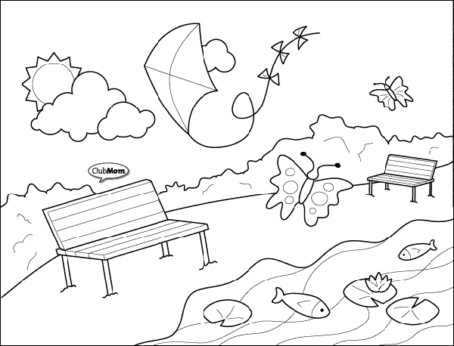
Look read and understand:
ذهبتُ=I went
أذهبُ=I go
سأذهبُ=I will go
Then=ثم
سوق=market
السّوق= the market
متحف=museum
المتحف=the museum
اليوم.....................إلى السّوق
غَدًا.......................إلى الْحَدِيقَةِ
الْبَارِحَة.....................إلى الْمَسْبَحِ
Write the appropriate verb in the gap
Yesterday the weather was cold I went to the Market then to the swimming pool
…................................................................................................................................................................
Tomorrow the weather will be hot I will go to the swimming pool.
..................................................................................................................................................................
Today is windy. I go to the park.
.................................................................................................................................................................................
Translate the sentences below
عندما كان الطقس مشمشا ذهبت إلى الحديقة

Slide 10
عِنْدَمَا
when
عندما كان الطقس مشمسا ذهبت إلى البيت.
Translate the following sentences:
When the weather is cold, I go to the park.
….........................................................................................................................................................................................................
When the weather was hot I went to the hotel.
.............................................................................................................................................................................................................
When the weather was snowy I went to airport.
..............................................................................................................................................................................................................
When the weather was foggy, I went to the shops.
...........................................................................................................................................................................................................

Slide 11
Word search:
Sunny
Windy
Cloudy
Foggy
Rainy
Weather
When
Was
I went
غ | ض | ر | ت | ف | م
ا | ب | ج | ث | ش | م
ئ | ا | ظ | م | ك | ط
م | ب | س | ث | ا | ر
ذ | ي | ر | ت | ن | ا
س | ق | ط | ل | ا | و
ذ | ب | ت | ب | هـ | ذ
ا | م | د | ن | ع | ق
غ | ن | ف | ص | ا | ع
الطقس غائم
ذهبت إلي المتحف
ذهبت إلى المكتبة

Slide 12
Write a paragraph of 150 words about your holidays , describing the places you visited .
All the vocabulary has been provided before, please check your spelling 0 tolerance with spelling mistakes especially about the words already in your sheets.
…............................................................................................................................................................................................................................................................................................................................................................................................................................................................................................................................................................................................................................................................................................................................................................................................................................................................................................................................................................................................................................................................................................................................................................................................................................................................................................................................................................................................................................................................................................................................................................................................................................................................................................................................................................................................................................................................................................................................................

