Slide 1

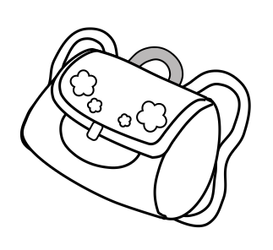
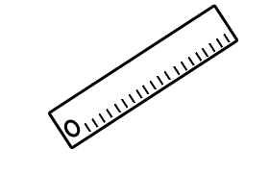

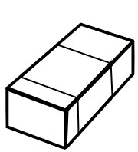



أَنَا عِنْدِي
I have

Slide 2
Colour the pictures and then write a sentence using adjectives and colours
بَيْضأء | أَيْيض
سَوْدَاء | أَسْوَد
صَفْرَاء | أَصْفَر
حَمْرَاء | أَحْمَر
خَضْرَاء | أَخْضَر
زَرْقَاء | أَزْرَق
بُنِّيَّةٌ | بُنِّـي
بُرْتُقَالِيَّةٌ | بُرْتُقَالِي
رَمَادِيَّةٌ | رَمَادِي
بَنَفْسَجِيَّةٌ | بَنَفْسَجِي
وَرْدِيَّةٌ | وَرْدِي
Big | كَبِير
Small | صغِير
Tall/long | طَوِيل
short | قَصِير
Beautiful | جَمِيل

Slide 3
Colour and write:
.......................................................................................................................................................
.......................................................................................................................................................
.......................................................................................................................................................
.......................................................................................................................................................

Slide 4
.......................................................................................................................................................
.......................................................................................................................................................
.......................................................................................................................................................
.......................................................................................................................................................

Slide 5
.......................................................................................................................................................
.......................................................................................................................................................
.......................................................................................................................................................
.......................................................................................................................................................

Slide 6
.......................................................................................................................................................
.......................................................................................................................................................
.......................................................................................................................................................
.......................................................................................................................................................

Slide 7
.......................................................................................................................................................
.......................................................................................................................................................
.......................................................................................................................................................
.......................................................................................................................................................

Slide 8
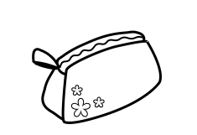
.......................................................................................................................................................
.......................................................................................................................................................
.......................................................................................................................................................
.......................................................................................................................................................

Slide 9
.......................................................................................................................................................
.......................................................................................................................................................
.......................................................................................................................................................
.......................................................................................................................................................

Slide 10

أَنَا عِنْدِي
.......................................................................................................................................................
.......................................................................................................................................................
.......................................................................................................................................................
.......................................................................................................................................................

Slide 11
أَنَا عِنْدِي
.......................................................................................................................................................
.......................................................................................................................................................
.......................................................................................................................................................
.......................................................................................................................................................

Slide 12
…………………………………………………………………………………………………………………………………………………………….
……………………………………………………………………………………………………………………………………………………………….
…………………………………………………………………………………………………………………………………………………………………
……………………………………………………………………………………………………………………………………………………………..
…………………………………………………………………………………………………………………………………………………………….
……………………………………………………………………………………………………………………………………………………………
…………………………………………………………………………………………………………………………………………………………..
…………………………………………………………………………………………………………………………………………………….........

